Slide 1
PSFD PRESENTATION
TEAM:-
S.J SUMANTH(2010030377)​
K.SREEVARUN(200030451)​
E. PAVAN SAI(2010030538)​
E. SHIVA GOUD(2010030542)​

Slide 2
Handwritten Digit Recognition using Python
REFERENCE: Deep Learning Project - Handwritten Digit Recognition using Python - DataFlair (data-flair.training)

Slide 3
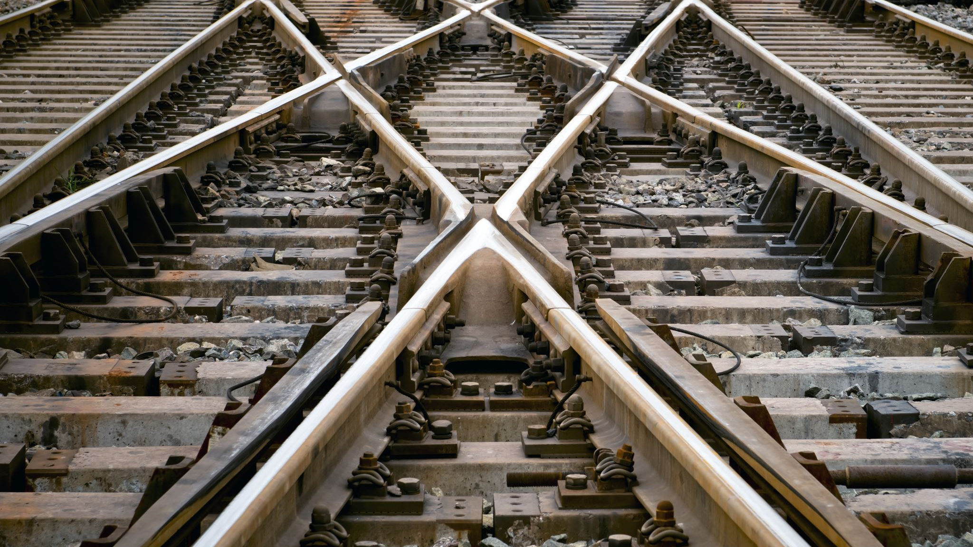
Outline
Abstract
Introduction
Implementation
Results
GitHub Commits
Conclusion

Slide 4
Abstract
Optical Character Recognition (OCR) is a subfield of Image Processing which is concerned with extracting text from images or scanned documents.
An OCR system depends mainly on feature extraction, recognition and classification into appropriate labels.
In this project, we have chosen to focus on recognizing handwritten digits with at most accuracy.
The challenge in this project is to use CNN algorithm, in order to maximize the accuracy of predicting the handwritten digits.

Slide 5
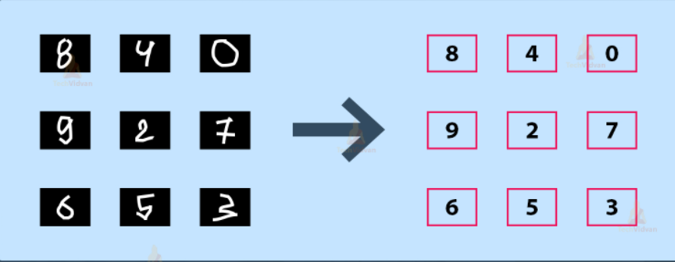
Introduction
It is easy for the human brain to process images and analyze them. When the eye sees a certain image, the brain can easily segment it and recognize its different elements. The brain automatically goes through that process, which involves not only the analysis of this images, but also the comparison of their different characteristics with what it already knows in order to be able to recognize these elements. There is a field in computer science that tries to do the same thing for machines, which is Image Processing.
Image processing is the field that concerns analyzing images to extract some useful information from them. This method takes images and converts them into a digital form readable by computers, it applies certain algorithms on them, and results in a better-quality images or with some of their characteristics that could be used in order to extract some important information from them.

Slide 6
Implementation

Slide 7


Slide 8


Slide 9


Slide 10


Slide 11

Results

Slide 12
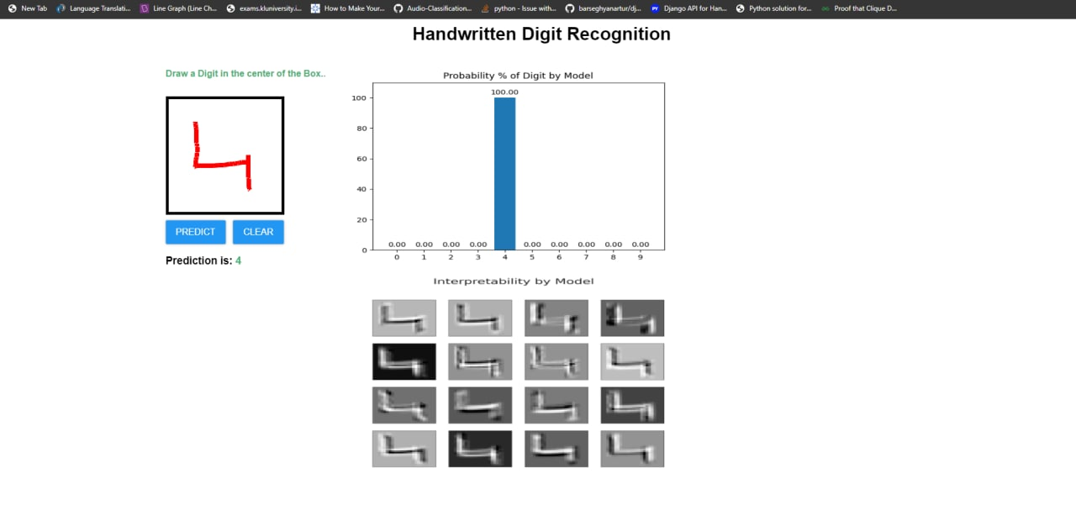

Slide 13
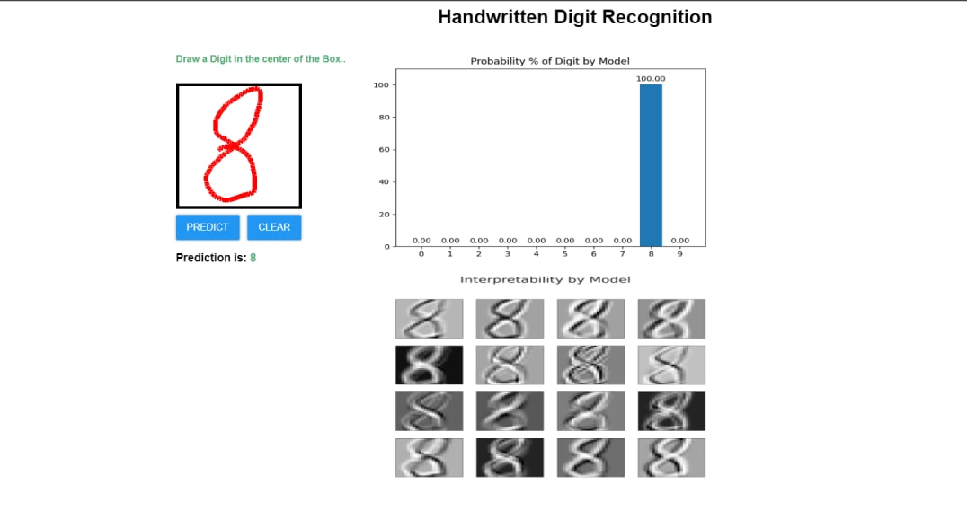

Slide 14

GITHUB commits:

Slide 15

Conclusion:
Several OCR systems were studied and accurate methods, techniques were analyzed. OCR is a challenging area of research and introduces new challenges with its changing dynamics.
The most widely used Machine learning algorithm i.e CNN will be trained and tested on the same dataset in order acquire the comparison between the classifiers. Utilizing these deep learning techniques, a high amount of accuracy can be obtained

Slide 16


